Slide 1
A Recommendation System for restaurant Contractors

Slide 2
Part 1- problem description
Restaurant contractors specialize in managing the supply chain for restaurants in consumables like groceries, bakery items, fruits, dairy products and other consumables.
Contractors in Toronto would like to see which areas in Toronto have high revenue potential
The objective is to explore the areas in Toronto holding huge earning potential where their services could be used to full extent
The contractors would also like to focus on the North York area of Toronto and examine areas in and around the neighborhood of North York which provides more service opportunities.
The contractors want to build a storage unit for the groceries they buy from villagers and farmers inside the borough and also reduce the transportation costs for the Restaurant owners with Transportation logistic services

Slide 3
Who would be interested in this project
Restaurant managers in Toronto would like to explore the Toronto area to see what kind of venues exist and what kind of restaurants will be suitable for the neighborhood
Transportation service providers would like to see which areas in Toronto would need time crucial transportation services especially perishables
Residents of Toronto would like to know about the kind or restaurants available in Toronto and know where specialty restaurants like Thai Restaurant or Vietnamese restaurants are available
Residents of North York, Toronto would like to see the most common venues in their area

Slide 4
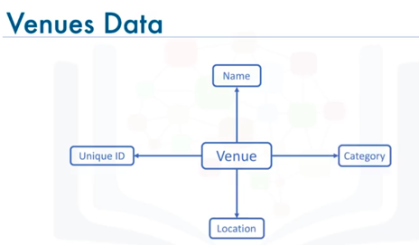
Part 2 - DATA description
Wikipedia :
https://en.wikipedia.org/wiki/List_of_postal_codes_of_Canada:_M
Is used to collect information about Toronto neighborhoods and their postal codes
Geospatial coordinates csv file of the neighborhoods using the Geocoder package, having geographical coordinates of each postal code: http://cocl.us/Geospatial_data
https://api.foursquare.com api is used to
get Location details like venues

Slide 5
Methodology
Scripting Language - Python (Python 3x)
IDE - https://labs.cognitiveclass.ai/tools/jupyterlab
Packages used - BeautifulSoup package for web scraping
- Sklearn for forming neighborhood clusters based on
venue categories using unsupervised k-means
clustering algorithm

Slide 6
Python packages :
Pandas - Library for Data Analysis
NumPy – Library to handle data in a vectorized manner
JSON – Library to handle JSON files
Geopy – To retrieve Location Data
Requests – Library to handle http requests
Matplotlib – Python Plotting Module
Sklearn – Python machine learning Library
Folium – Map rendering Library

Slide 7
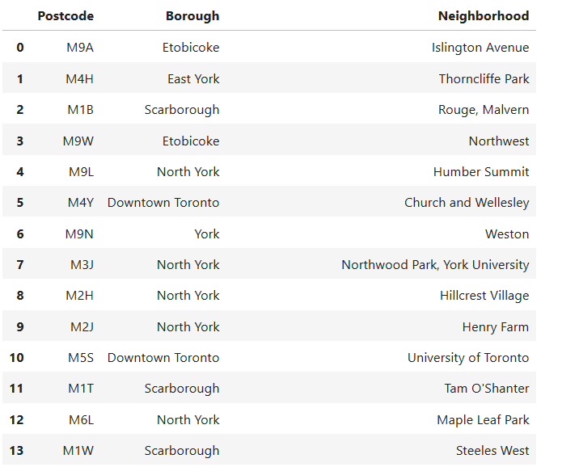
Toronto – Boroughs with postal codes
Representative list :

Slide 8
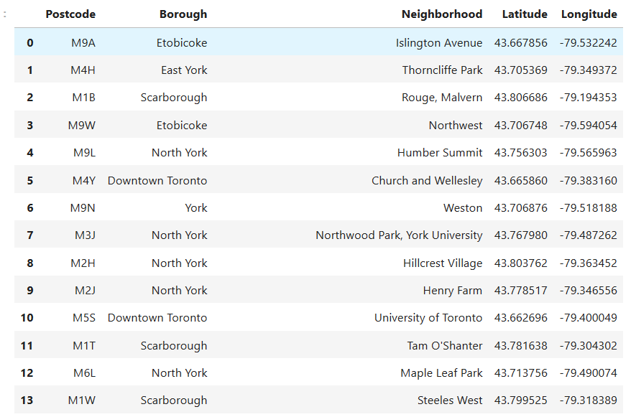
Toronto neighborhood with Latitude & Longitude information

Slide 9
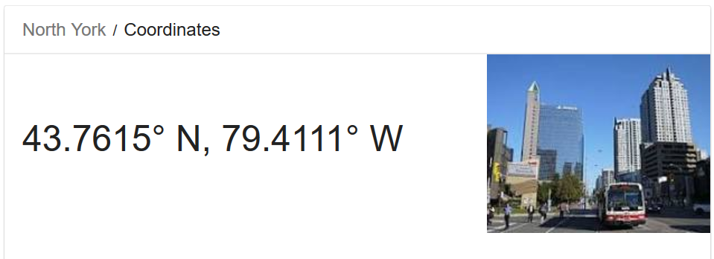
North York- longitude and Latitudes

Slide 10
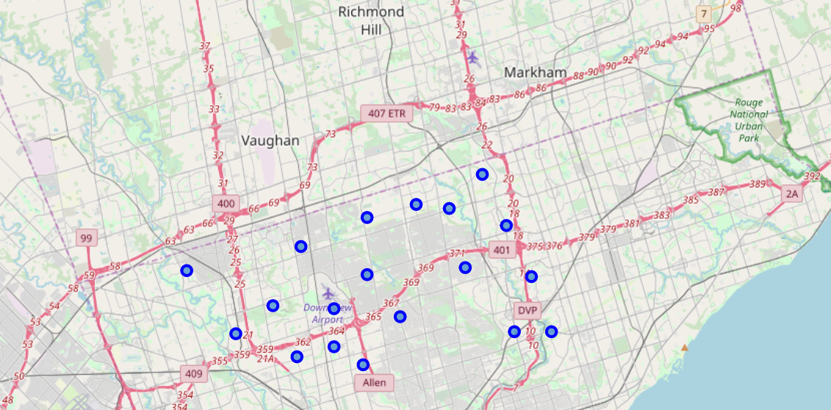
Map of North York, Toronto

Slide 11
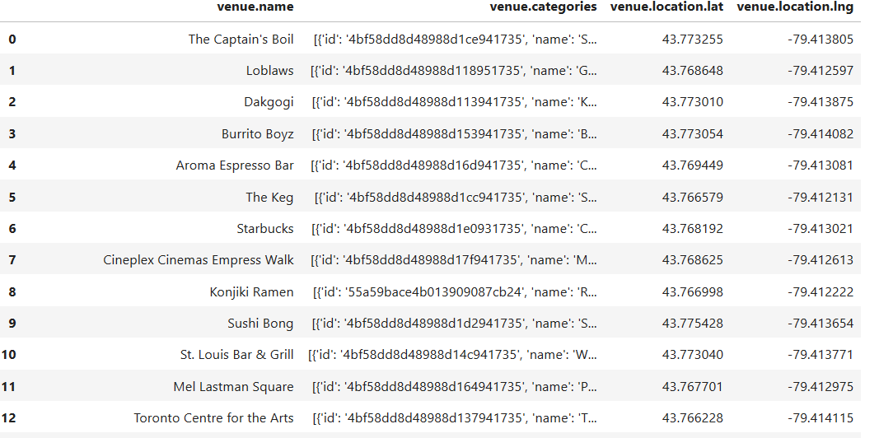
Venues in North York, Toronto
Representative sample

Slide 12
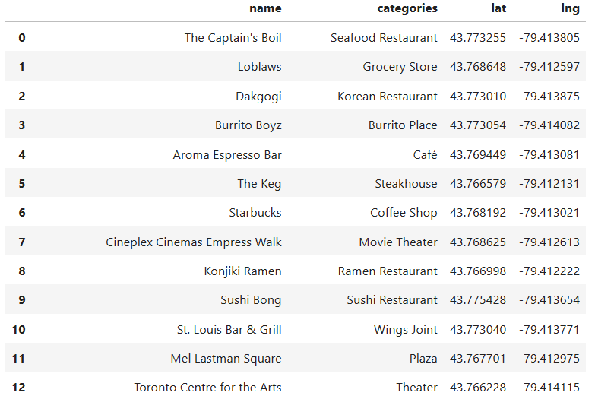
Venues in North York, Toronto with categories

Slide 13
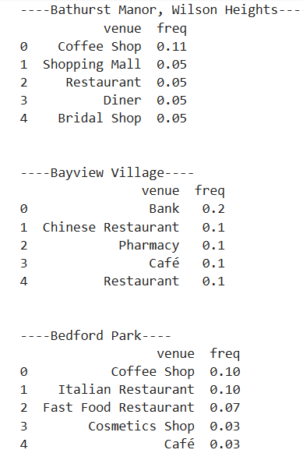
Neighborhood with venue details

Slide 14
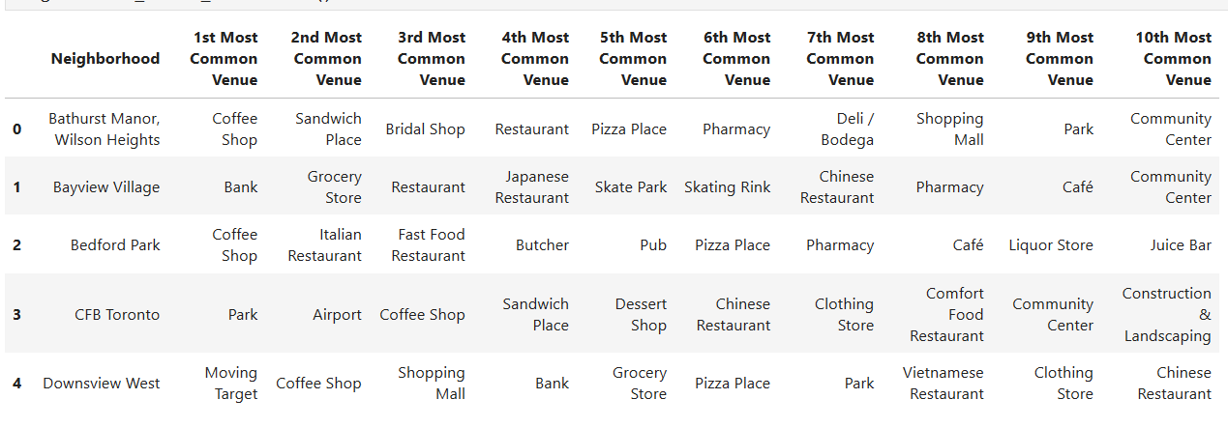
Most common Venues

Slide 15
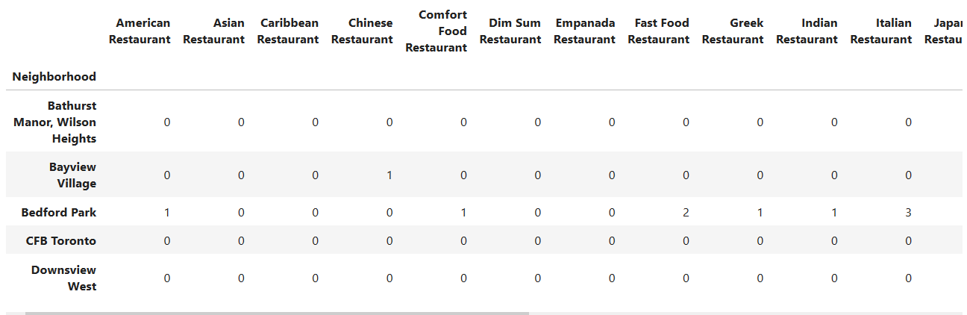
Explore restaurants in North York, Toronto

Slide 16
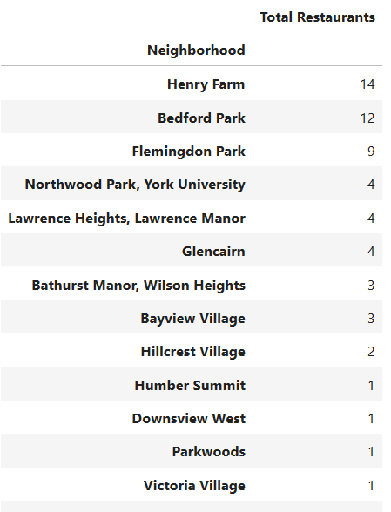
Explore restaurants in North York, Toronto

Slide 17
Neighborhood recommendation
Below are the areas where the number of restaurants are the highest hence having potential for higher revenues for Restaurant operational service support
The best Neighborhood is Henry Farm with 14 restaurants
Second best Neighborhood is Bedford Park with 12 restaurants
Third best Neighborhood is Flemingdon Park with 9 restaurants

Slide 18
Thank you

